Slide 1

Mental Health Programs for Schools
Executive Director, Heather Smith
Director of Programs, Julia Saldanha

Slide 2
NAMI of Southwest Ohio
Is one of 600 local affiliates of the National Alliance on Mental Illness, NAMI, which is the nation’s largest grassroots organization for mental health
Is dedicated to building better lives for all those in Southwest Ohio affected by mental health conditions through education, support, advocacy, and public awareness
Serves Hamilton, Warren, Clinton, Butler, and Clermont Counties
Provides educational classes for individuals living with a mental health condition and families who are affected by mental illness
Leads support groups for individuals living with a mental health condition and for family members
Presents NAMI Signature Programs to schools, universities, faith communities, businesses, law enforcement and first responders
Provides an Information and Referral helpline

Slide 3
Ending the Silence - FAQs
Signature NAMI presentation developed at the national level
Evidence based; Studies have shown that Ending the Silence increases help-seeking
Three modules - middle and high school students, parents, and staff
Presentation to students can be fit into a class bell, class setting recommended
Parents and staff presentations are 60- 90 minutes
PowerPoint contains facts, information and videos; delivered by a trained NAMI presenter with a personal connection to mental health,
Young adult who lived with mental illness while in school shares personal story
Can be delivered virtually during the pandemic and in-person after
Offered at NO COST

Slide 4
Ending the Silence –What Does it Cover?
warning signs and symptoms of mental illness and suicide
statistics on how mental illness affects youth
different mental health disorders
stigma surrounding mental illness, language and ways to reduce stigma
bullying

Slide 5
Ending the Silence –What Does it Cover?
Local and national resources
Recovery, coping skills, ways to maintain good mental health
How to help a friend, student or loved one
Communication between parents/caregivers and school staff; accommodations
Opportunity for Q&A

Slide 6
Ending the Silence
We have presented ETS for families at
Mt. Healthy Upward Bound Program
West Clermont High School
Anderson High School
Norwood Middle School Hope Squad
Bishop Fenwick High School
Summit Country Day High School
Dayton Regional Stem School
Indian Hills High School
Oak Hills High School
Ross High School
Loveland Middle School
Norwood Middle School Hope Squad
Hope Squad Conference
Middletown High School
Fairfield Academy
Kettering Fairmont High School
Knox Presbyterian Church Youth Group
We have presented ETS for students at…
North College Hill
Child Focus
NAMI SWOH’s Hot Topics
Dayton Regional Stem School
Knox Presbyterian Youth Group Parents
The Asian Community Alliance
We have presented ETS for staff at
Dayton Regional Stem School
Ohio Jobs and Family Services
Ohio Department of State,
Ugandan Delegation
…

Slide 7
People Reached
In the school year 2019-2020, we presented ETS to
In the school year 2018-2019, we presented ETS to
1433 students
39 staff members
32 family members and caregivers
4222 students
9 staff members
55 family members and caregivers
…

Slide 8
Ending the Silence Testimonials
Students
"It was inspiring to me because I could relate personally and it reminded me I'm not alone."
"I really thought that I was the only one who felt the way those people were saying. I like how they make people feel normal."
"The presenters seemed like everyday people who just wanted to help, not to lecture."
"Hearing about other people's life stories. It's easier to understand when hearing people tell their story. It sticks with you and you remember it."

Slide 9
Ending the Silence Testimonials
Families:
"Presenters were very honest and 'real'. Slides were very practical and immediately useful.“
"Lots of helpful resources and tips for communication and identification of issues.“
Staff:
"Wow! What an amazing program to advocate/educate for mental illness."

Slide 10
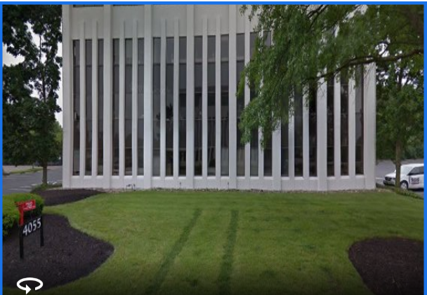
Contact us :
Director of Programs, Julia Saldanha
Call/text at 513-668-4760
Or email Julia.Saldanha@namiswoh.org
Call NAMI of Southwest Ohio at (513) 351-3500
Or email info@namiswoh.org
4055 Executive Park Dr, Suite 450
Cincinnati, OH 45241

